Slide 1


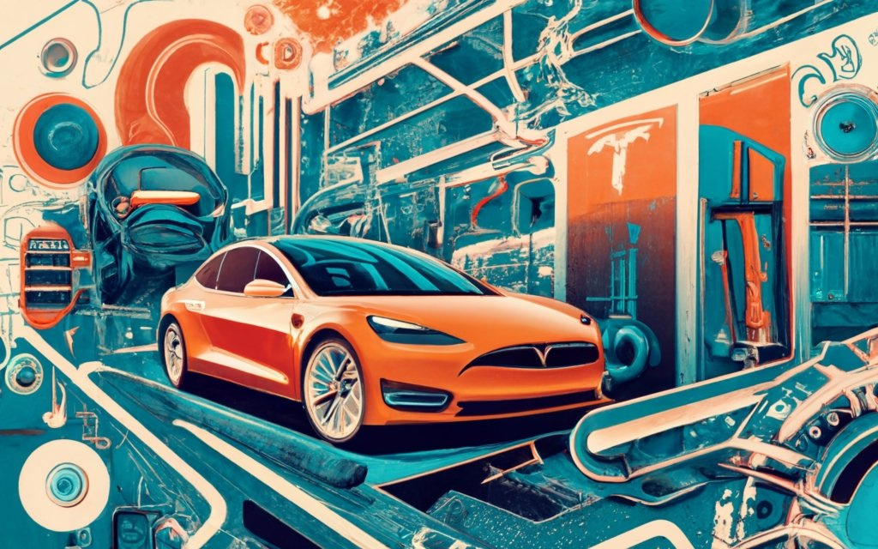

SWOT ANALYSIS OF TESLA
WWW.STRATEGYPUNK.COM

Slide 2



SWOT ANALYSIS OF TESLA
  Strengths
  Weaknesses
  Brand Power: Tesla is iconic. Synonymous with electric cars.
  Innovation: Always ahead. Pushing boundaries.
  Supercharger Network: Charging? Fast and widespread.
  Self-driving Tech: Autopilot. A game-changer.
  Production Delays: High demand. Sometimes, slow delivery.
  Quality Issues: Some cars had glitches. Customers noticed.
  High Prices: Premium brand. Not everyone can afford it.
  Opportunities
  Threats
  Emerging Markets: Asia. Africa. Untapped potential.
  Energy Solutions: Beyond cars. Solar. Storage.
  Public Transport: Electric buses? Maybe.
  Competition: Other brands are catching up. Electricity is the future.
  Regulations: Governments. Rules. Always changing.
  Battery Supply: High demand. Limited resources.
WWW.STRATEGYPUNK.COM

