Slide 1
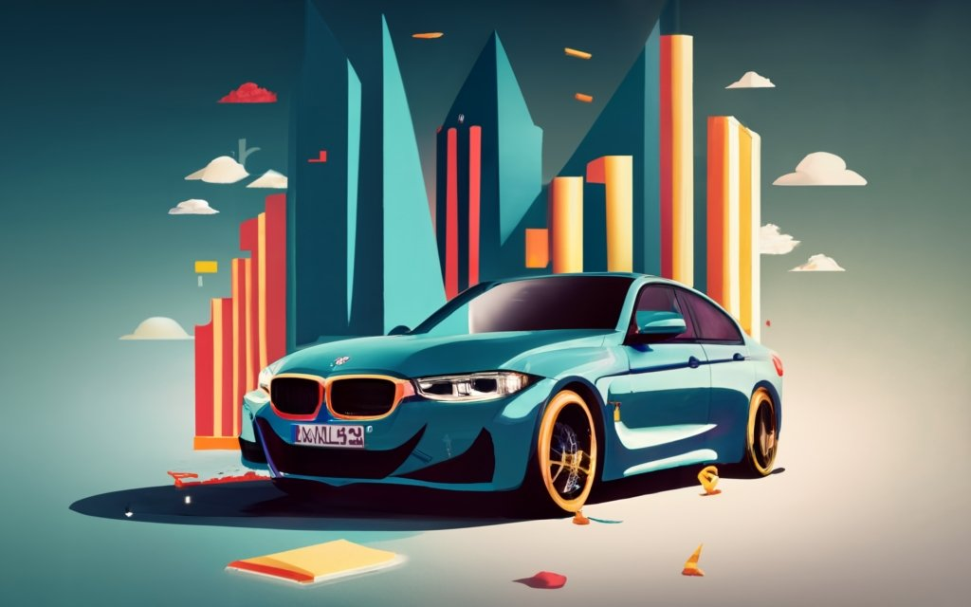
SWOT ANALYSIS OF BMW
WWW.STRATEGYPUNK.COM

Slide 2
SWOT ANALYSIS OF BMW
Strengths
Weaknesses
Esteemed brand reputation for performance and luxury.
Diverse product range including sporty coupes, luxury sedans, and SUVs.
Pioneering technology in engines, aerodynamics, and driver assistance.
Significant global scale with 31 manufacturing facilities across 15 countries.
High manufacturing costs impacting profit margins.
Sluggish transition to electric vehicles with a limited EV portfolio.
Heavy reliance on the luxury market, sensitive to economic downturns.
Potential brand dilution from lower-priced models like 1 Series and X1.
Opportunities
Threats
Booming SUV demand enhancing revenue prospects.
China's burgeoning auto market aligning with BMW’s brand allure.
Promising EV market with potential for 30% of total sales by 2025.
Autonomous driving technology offering differentiation and new revenue channels.
Rising competition from premium brands like Mercedes and Audi.
Trade tensions, particularly between the US and China, escalating costs.
Economic downturns directly affecting luxury auto sales.
Stringent regulations necessitating costly vehicle redesigns.
WWW.STRATEGYPUNK.COM

