Slide 1
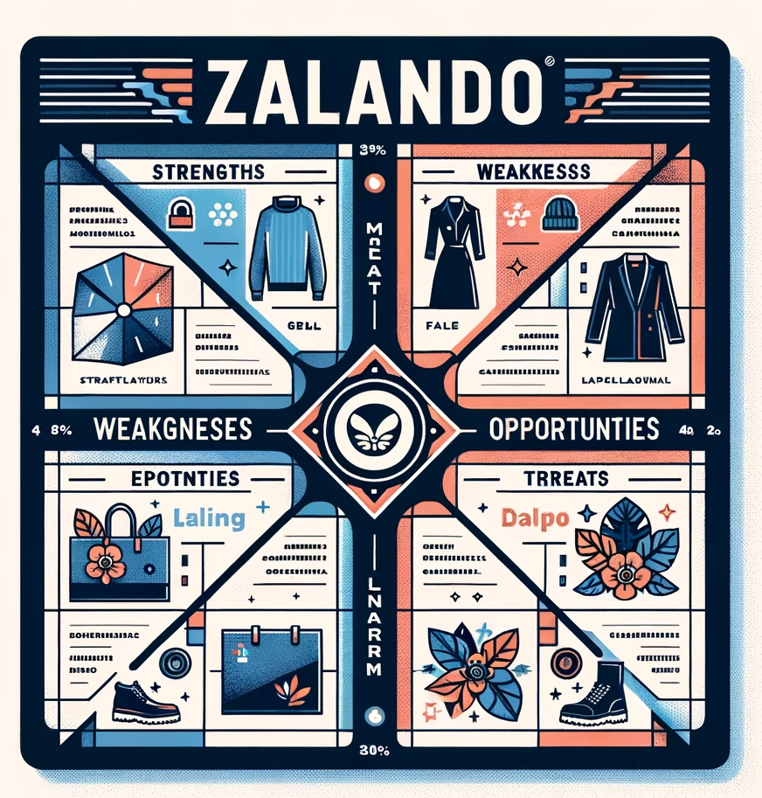
SWOT ANALYSIS OF ZALANDO
WWW.STRATEGYPUNK.COM

Slide 2
SWOT ANALYSIS OF ZALANDO
Strengths
Weaknesses
Europe's top online fashion brand with vast product range.
Advanced tech & data analytics for personalized shopping.
Robust fulfillment infrastructure across Europe.
Commitment to sustainability appealing to eco-conscious consumers.
Over-reliance on European market.
Struggles with profitability due to high costs.
Elevated product return rates.
Faces stiff competition and complex supply chain management.
Opportunities
Threats
Expansion to markets outside Europe.
Potential growth in private labels.
Monetizing data analytics.
Capitalizing on the shift to online fashion and strategic acquisitions.
Increasing competition from giants like Amazon.
Brands adopting direct-to-consumer models.
Economic downturns impacting consumer spending.
Dependence on discounts & potential environmental concerns.
WWW.STRATEGYPUNK.COM

