Slide 1
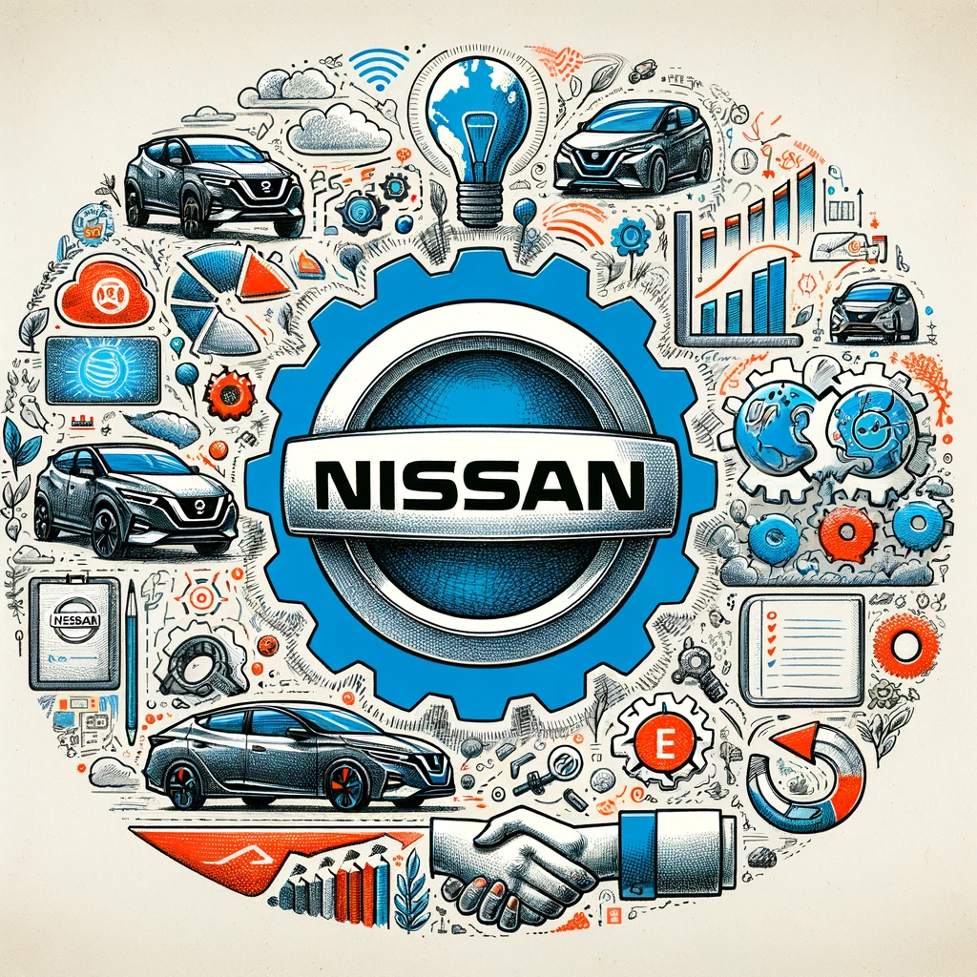
SWOT ANALYSIS OF NISSAN
WWW.STRATEGYPUNK.COM

Slide 2
SWOT ANALYSIS OF NISSAN
Strengths
Weaknesses
Strong global brand with household names like Nissan, Infiniti, and Datsun.
Diverse vehicle lineup, from affordable cars to luxury sports models.
Extensive global reach, selling in over 190 countries.
Strong market position in China and early leadership in electric vehicles.
Declining profits and sales, particularly in the US market.
Quality issues leading to significant recalls impacting brand image.
Overlapping brands and models causing internal competition.
Fallen behind in the rapidly growing EV market compared to rivals.
Opportunities
Threats
Rising demand for SUVs and crossovers in major markets.
Potential expansion in developing markets with growing automobile demand.
Opportunity to lead in the electric vehicle space by leveraging early investments.
Prospects in autonomous driving technology and beneficial partnerships.
Intensifying competition from EV startups, tech companies, and traditional automakers.
Slowing auto sales in China amid economic and trade challenges.
Rising costs due to new technology investments and regulatory pressures.
Currency fluctuation risks, particularly with the Japanese Yen
WWW.STRATEGYPUNK.COM

