Slide 1


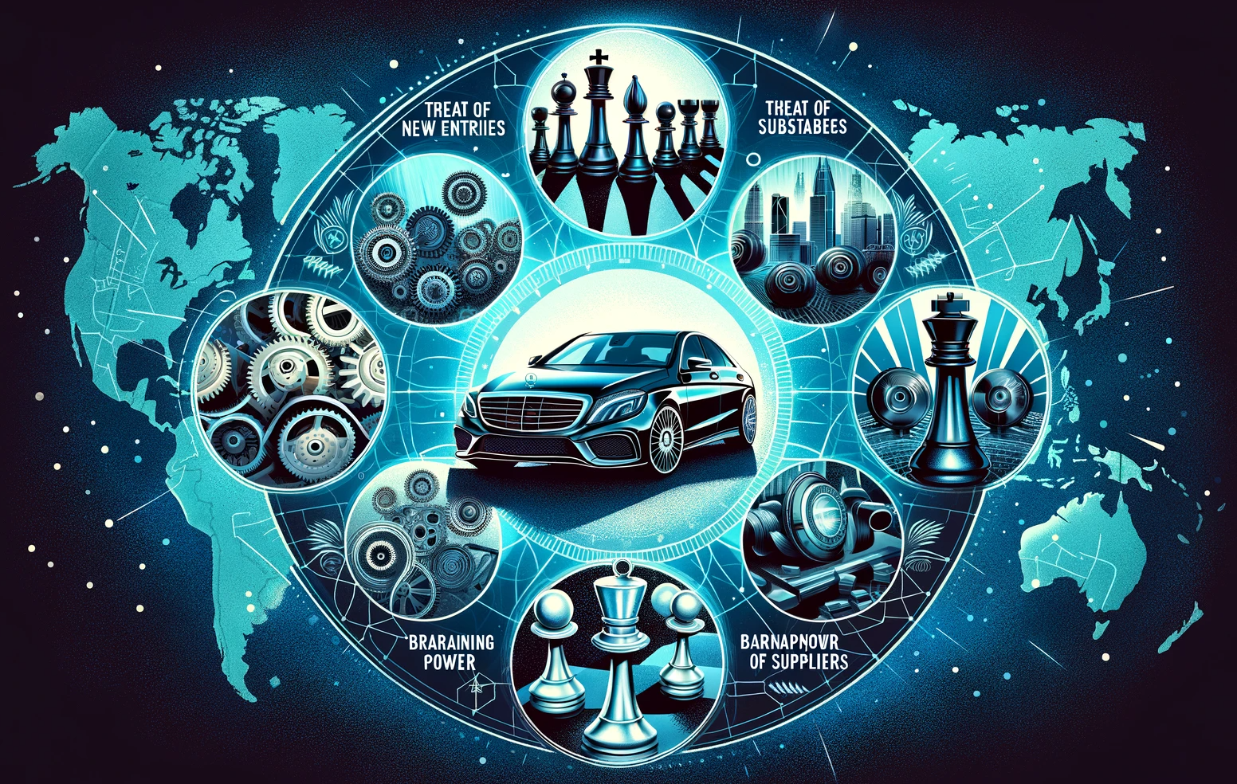
Porter's Five Forces
Mercedes Benz
www.strategypunk.com

Slide 2















Porter's Five Forces – Mercedes Benz
Threat of New Entrants (Moderate)
High capital industry, yet Tesla shows potential for disruption.
Legacy advantages in manufacturing and distribution networks.
Need for digital agility and faster shift to electric drivetrains.
Focus on unmatched customer experiences to build loyalty.
Threat New Entrants
Threat of Substitute (Moderate)
Rise of ride-hailing and carsharing services poses challenges.
Wealthy consumers still value personalized luxury vehicles.
Innovations and flexible subscription models to counter substitutes.
Potential future mobility-as-a-service offerings through autonomous tech.
Bargaining Power of Suppliers (Low)
Extensive supply chain with many small suppliers.
Leverage to negotiate prices due to size and scale.
Strategies include increasing vertical integration and consolidating suppliers.
Development of alternative sources and localized production.
Competitive
Rivalry
Suppliers
Buyers
Bargaining Power of Buyers (Moderate)
Individual luxury buyers have limited influence over pricing/design.
Large fleets and government buyers hold some power.
Focus on customized experiences for luxury buyers.
Expansion into affordable segments and innovative electric/self-driving cars.
Substitutes
Competitive Rivalry (High)
Intense global competition, especially from German peers and Tesla.
Low switching costs and fierce competition for market share.
Expansion into electric vehicles and strategic partnerships to maintain an edge.
Investment in emerging technologies like self-driving cars.
www.strategypunk.com

