Slide 1
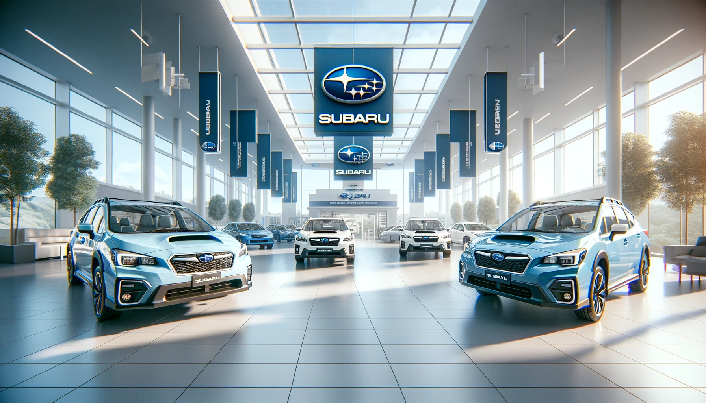
SWOT
ANALYSIS
Subaru
2024
www.strategypunk.com

Slide 2
STRENGHTS
SWOT
ANALYSIS
Subaru
2024
WEAKNESSES
OPPORTUNITIES
THREATS
www.strategypunk.com

Slide 3
SWOT ANALYSIS – Subaru 2024
STRENGTHS
WEAKNESSES
OPPORTUNITIES
THREATS
Safety Reputation: Known for producing safe, durable vehicles.
AWD Expertise: Superior all-wheel drive technology.
Product Innovation: Strong in drivetrain and safety system development.
High Sales: Consistent global sales success.
Electrification Delay: Slow entry into hybrid/electric vehicle market.
Brand Awareness: Lower recognition compared to major competitors.
Dealer Network Size: Limited compared to larger automakers.
Supply Chain Risks: Reliance on Japanese manufacturing.
SUV/Crossover Trend: Growing global demand in Subaru's strong segments.
Market Expansion: Potential in international markets.
Electric Vehicles: Opportunities in developing electric SUVs/CUVs.
Tech Partnerships: Alliances in electrification and autonomous tech.
ntense Competition: Increasing pressure in key market segments.
EV Transition: Resource and technology challenges.
Sales Growth Risk: Potential for plateau in a competitive market.
Economic Instability: Sensitivity to global economic shifts.
www.strategypunk.com

