Slide 1
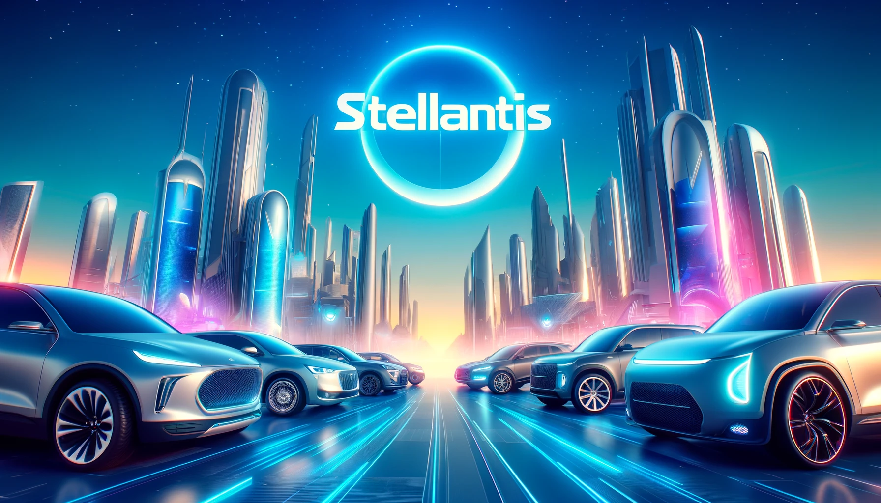
PESTLE
ANALYSIS
Stellantis
2024
www.strategypunk.com

Slide 2
PESTLE ANALYSIS – Stellantis 2024
P
POLITICAL
E
ECONOMIC
S
SOCIAL
POLITICAL FACTORS
Governmental policies on emissions: Stellantis faces strict regulations across different markets, influencing vehicle design and market strategy.
Trade agreements and tariffs: Changes in trade policies, especially in the EU and US, affect Stellantis’ production costs and pricing strategies.
Subsidies for electric vehicles: Stellantis could benefit from government financial incentives in regions promoting eco-friendly cars.
Brexit implications: Brexit continues to affect Stellantis' operations regarding tariffs, supply chain disruptions, and regulatory compliance.
T
TECHNOLOGICAL
L
LEGAL
E
ENVIRONMENTAL
www.strategypunk.com

Slide 3
PESTLE ANALYSIS – Stellantis 2024
P
POLITICAL
E
ECONOMIC
S
SOCIAL
ECONOMIC FACTORS
Global economic volatility: Economic downturns in key markets could impact consumer purchasing power and sales volumes.
Currency fluctuations: As a global company, Stellantis is exposed to risks associated with exchange rate variability.
Rising raw material costs: Increases in steel, aluminum, and other materials directly impact production costs.
Shifts in consumer spending: Economic recoveries could steer consumers towards higher-priced or technologically advanced models.
T
TECHNOLOGICAL
L
LEGAL
E
ENVIRONMENTAL
www.strategypunk.com

Slide 4
PESTLE ANALYSIS – Stellantis 2024
P
POLITICAL
E
ECONOMIC
S
SOCIAL
SOCIAL FACTORS
Changing consumer preferences: There is a growing demand for electric and hybrid vehicles among environmentally conscious consumers.
Urbanization trends: Increased urbanization is influencing the types of vehicles in demand, such as compact cars.
Demographic shifts: Aging populations in developed markets could affect the demand for different types of vehicles.
Cultural influences on vehicle ownership: In some regions, cultural trends are shifting away from vehicle ownership in favor of sharing services.
T
TECHNOLOGICAL
L
LEGAL
E
ENVIRONMENTAL
www.strategypunk.com

Slide 5
PESTLE ANALYSIS – Stellantis 2024
P
POLITICAL
E
ECONOMIC
S
SOCIAL
TECHNOLOGICAL FACTORS
Advancements in electric vehicle technology: Stellantis is investing in electric and hybrid technologies to stay competitive.
Development of autonomous driving systems: The push towards self-driving cars presents opportunities and challenges for Stellantis.
Increased use of AI and machine learning: These technologies are integrated into vehicle systems for enhanced performance and safety.
Connectivity and infotainment systems: There is a rising expectation for advanced in-vehicle technology among consumers.
T
TECHNOLOGICAL
L
LEGAL
E
ENVIRONMENTAL
www.strategypunk.com

Slide 6
PESTLE ANALYSIS – Stellantis 2024
P
POLITICAL
E
ECONOMIC
S
SOCIAL
LEGAL FACTORS
Vehicle safety regulations: Compliance with international safety standards is mandatory and influences design and production.
Emissions standards: Stricter emissions regulations require significant investment in cleaner technology.
Labor laws: Operations worldwide are subject to varying labor laws, affecting workforce management.
Intellectual property rights: Protecting innovations in technology and design is crucial amidst fierce competition.
T
TECHNOLOGICAL
L
LEGAL
E
ENVIRONMENTAL
www.strategypunk.com

Slide 7
PESTLE ANALYSIS – Stellantis 2024
P
POLITICAL
E
ECONOMIC
S
SOCIAL
ENVIRONMENTAL FACTORS
Carbon footprint reduction: Stellantis is compelled to reduce production and vehicle operation emissions.
Waste management and recycling: Regulations and corporate responsibility push for improved recycling and waste management practices.
Resource scarcity: The availability of sustainable and affordable raw materials is increasingly critical.
Impact of climate change: Operational adjustments are necessary to mitigate risks related to changing weather patterns and natural disasters.
T
TECHNOLOGICAL
L
LEGAL
E
ENVIRONMENTAL
www.strategypunk.com

