Slide 1
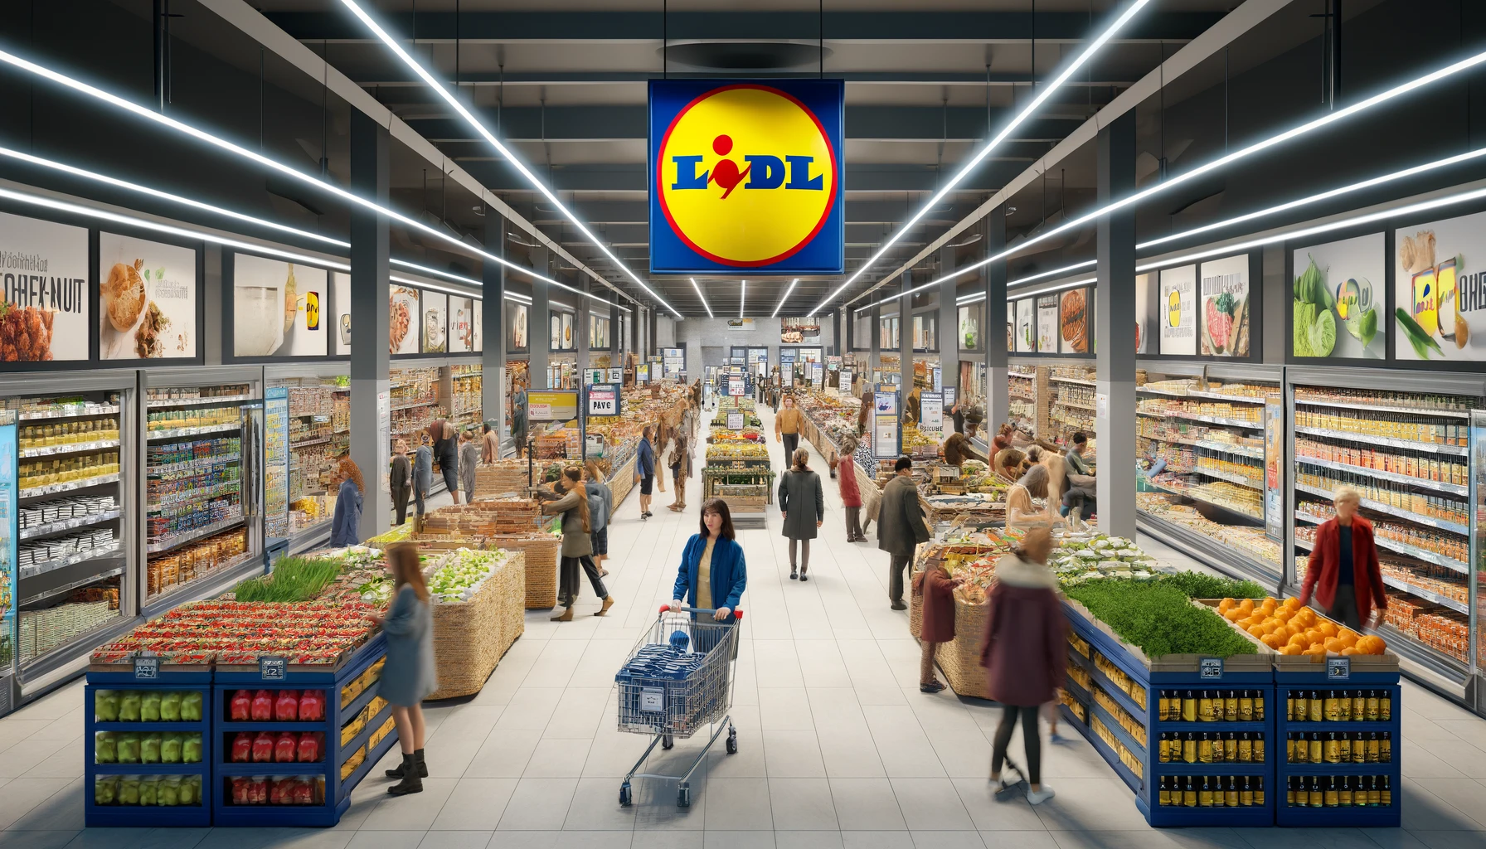
SWOT
ANALYSIS
Lidl
2024
www.strategypunk.com

Slide 2
STRENGHTS
SWOT
ANALYSIS
Summary
Lidl
WEAKNESSES
OPPORTUNITIES
THREATS
www.strategypunk.com

Slide 3
SWOT ANALYSIS – Lidl 2024
STRENGTHS
WEAKNESSES
OPPORTUNITIES
THREATS
Cost Leadership: Unbeatable prices through cost optimization.
Brand Equity: Trusted for high-quality, affordable groceries.
Operational Efficiency: Lean supply chain and efficient stores.
Global Footprint: Over 11,000 stores in 32 countries.
Limited Product Range: This may not meet all customer preferences.
Brand Perception: Discount image might suggest lower quality.
Dependence on Private Labels: Vulnerable to supply chain issues.
Limited Online Presence: Lagging e-commerce capabilities.
Market Expansion: Potential growth in new domestic and international markets.
Product Diversification: Adding organic, premium, and specialty items.
Technology Investment: Enhancing e-commerce and digital capabilities.
Sustainability: Eco-friendly practices to attract conscious consumers.
Intense Competition: Strong competition from other retailers.
Rising Costs: Inflation and increasing labor costs.
Supply Chain Disruptions: Vulnerability to geopolitical and natural disruptions.
Regulatory Challenges: Compliance with evolving regulations.
www.strategypunk.com

