Slide 1
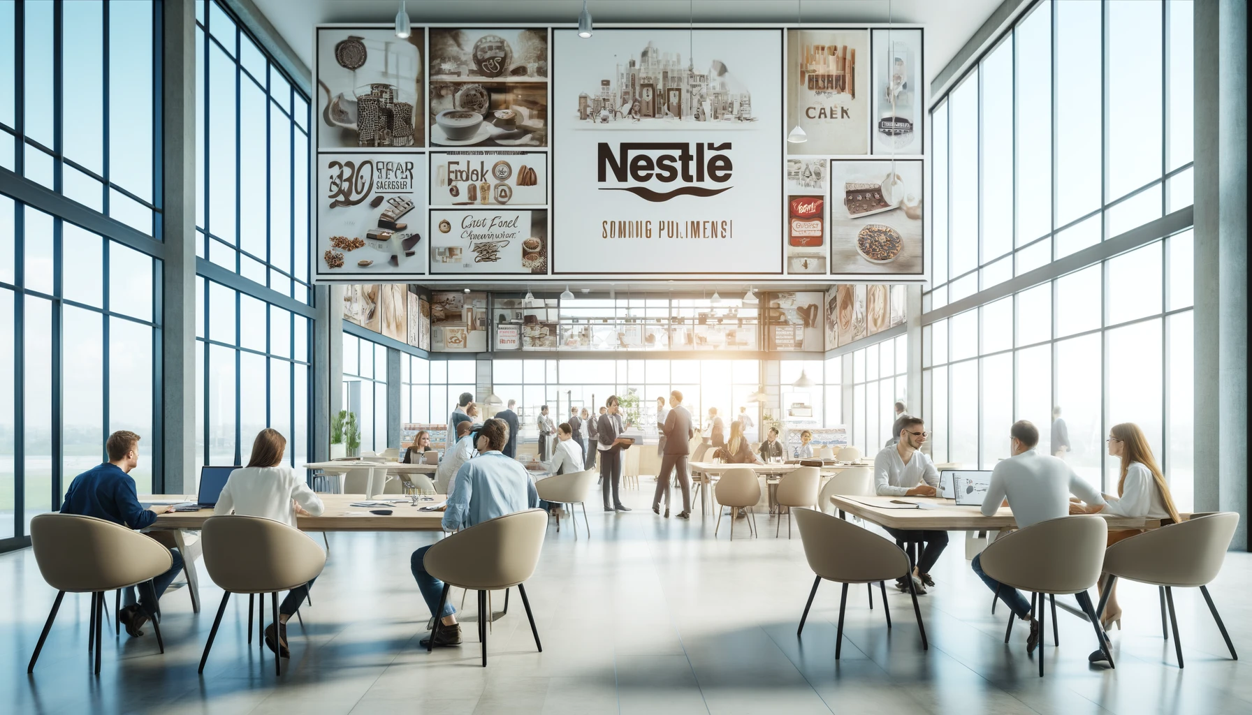
PESTLE
ANALYSIS
Nestlé
2024
www.strategypunk.com

Slide 2
PESTLE ANALYSIS – Nestlé 2024
P
POLITICAL
E
ECONOMIC
S
SOCIAL
POLITICAL FACTORS
Nestlé operates in 189 countries, so it must navigate complex political environments and regulations across different governments
Brexit created uncertainty for Nestlé's UK operations, leading it to consider moving some production to Poland
Nestlé faces scrutiny from governments over water bottling practices, depletion of water sources, and calls for tighter regulations
Changes in government policies, trade agreements, and geopolitical stability can significantly impact Nestlé's business operations
T
TECHNOLOGICAL
L
LEGAL
E
ENVIRONMENTAL
www.strategypunk.com

Slide 3
PESTLE ANALYSIS – Nestlé 2024
P
POLITICAL
E
ECONOMIC
S
SOCIAL
ECONOMIC FACTORS
Economic conditions like inflation, exchange rates, and growth patterns shape consumer demand and purchasing power for Nestlé's products
During economic downturns, consumers may opt for cheaper alternatives, impacting Nestlé's pricing strategies
In emerging markets with rising incomes, Nestlé can capitalize on increased demand for its products
Nestlé must adapt pricing, product offerings, and investments based on fluctuations in the broader economic climate
T
TECHNOLOGICAL
L
LEGAL
E
ENVIRONMENTAL
www.strategypunk.com

Slide 4
PESTLE ANALYSIS – Nestlé 2024
P
POLITICAL
E
ECONOMIC
S
SOCIAL
SOCIAL FACTORS
Evolving consumer preferences like health/wellness trends prompt Nestlé to reformulate products and reduce sugar/salt/fat
Concerns over ethical sourcing led to initiatives like the Cocoa Plan to improve cocoa farming communities
Nestlé faces scrutiny from consumer groups over marketing to children and the use of palm oil linked to deforestation
Changing demographics, cultural norms, and lifestyle trends influence Nestlé's product development and marketing strategies
T
TECHNOLOGICAL
L
LEGAL
E
ENVIRONMENTAL
www.strategypunk.com

Slide 5
PESTLE ANALYSIS – Nestlé 2024
P
POLITICAL
E
ECONOMIC
S
SOCIAL
TECHNOLOGICAL FACTORS
Nestlé invests heavily in R&D, leveraging AI, data analytics, and automation to optimize production and supply chain
Digital transformation through e-commerce, blockchain for supply chain transparency, and digital marketing campaigns
Adoption of new food processing and packaging technologies to drive innovation and meet changing consumer needs
Nestlé must keep pace with rapid technological shifts to maintain competitive edge and operational efficiency
T
TECHNOLOGICAL
L
LEGAL
E
ENVIRONMENTAL
www.strategypunk.com

Slide 6
PESTLE ANALYSIS – Nestlé 2024
P
POLITICAL
E
ECONOMIC
S
SOCIAL
LEGAL FACTORS
Nestlé must comply with laws/regulations on food safety, labeling, and advertising across its global markets
The company has faced legal battles over mislabeling, false advertising, and labor law violations in its supply chain
Changes in intellectual property laws can impact Nestlé's ability to protect brands and innovations
Nestlé navigates complex legal frameworks to avoid penalties and maintain a positive reputation
T
TECHNOLOGICAL
L
LEGAL
E
ENVIRONMENTAL
www.strategypunk.com

Slide 7
PESTLE ANALYSIS – Nestlé 2024
P
POLITICAL
E
ECONOMIC
S
SOCIAL
ENVIRONMENTAL FACTORS
Increasing environmental consciousness demands accountability on issues like climate change, water scarcity, and plastic pollution
Nestlé set ambitious targets like net-zero emissions by 2050 and 100% recyclable packaging by 2025
Environmental groups criticize Nestlé over water bottling, plastic waste, and agricultural supply chain impacts
Sustainable sourcing, reducing environmental footprint, and adapting to climate change are crucial for long-term success
T
TECHNOLOGICAL
L
LEGAL
E
ENVIRONMENTAL
www.strategypunk.com

