Slide 1

Market Sizing Framework
Understanding TAM, SAM, and SOM for Strategic Market Analysis
www.strategypunk.com

Slide 2
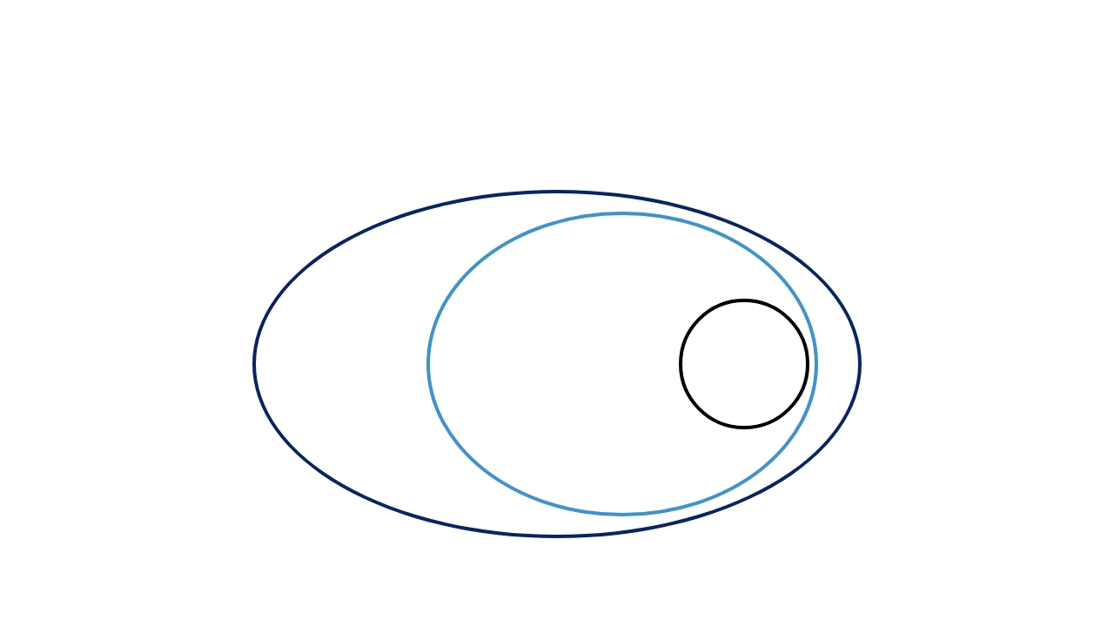
Understanding Market Size
The relationship between TAM, SAM, and SOM
TAM
SAM
SOM
Total Available Market
Serviceable Addressable Market
Your Share of Market
the whole market
the market segment you target
www.strategypunk.com

Slide 3



Understanding Market Size
The relationship between TAM, SAM, and SOM
Total Available Market
TAM
The entire market demand for a product or service
(the whole market)
Serviceable Addressable Market
SAM
The segment of TAM that you can realistically target
(the market segment you target)
Serviceable Obtainable Market
SOM
The portion of SAM that you can realistically capture
(your share of the market)
www.strategypunk.com

Slide 4
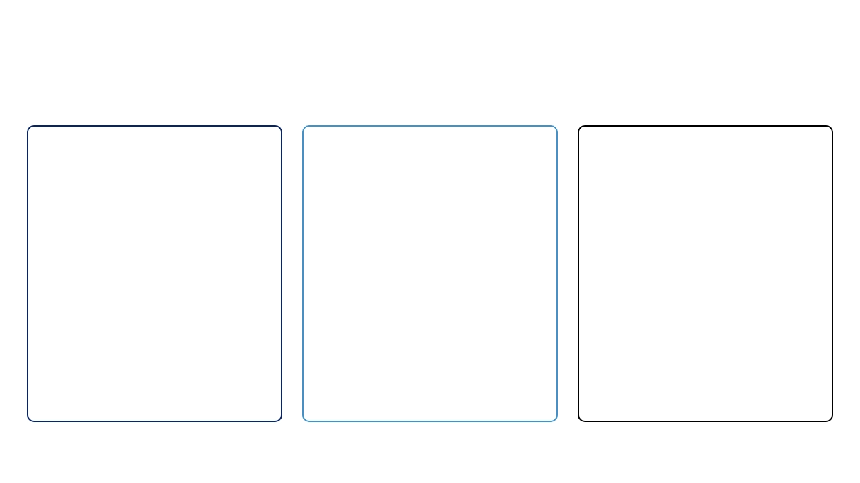



TAM, SAM, SOM Explained
Detailed breakdown of market sizing concepts
TAM
SAM
SOM
Total Available Market
Serviceable Addressable Market
Serviceable Obtainable Market
The total market demand for a product or service. This represents the maximum potential market size if 100% market share was achieved with no restrictions.
The segment of the TAM that is within your geographical reach and that you can realistically target with your product or service offering.
The portion of SAM that you can realistically capture in the short to medium term, considering your resources, competition, and go-to-market strategy.
Example:
For a smartphone manufacturer,
Example:
For a smartphone manufacturer,
Example:
For a smartphone manufacturer,
TAM would be the global annual spending on
SAM might be the premium smartphone
SOM might be their projected sales based on
all smartphones.
market in countries where they operate.
marketing budget, distribution channels, and
competitive landscape.
Calculation:
Total number of potential
Calculation:
Number of customers in target
customers × Average annual revenue per
segment × Average annual revenue per
Calculation:
Estimated market share
customer
customer in that segment
percentage × SAM
www.strategypunk.com

